Slide 1
ITALY RIPALIMOSANI (CAMPOBASSO) PRIMARY SCHOOL FOURTH CLASS
SCHOOL YEAR 2014/2015

Slide 2
WE LOVE OUR VILLAGE
MY VILLAGE

Slide 3
poem
A village is made of gardens
where few children play.
It is made of houses and churches,
there are slopes and descents.
There are shops, offices, gyms and restaurants with a lots of windows.
It has got library and one school,
a lot of quiet roads.
In a village there is few people
and you can know all cheerfully.

Slide 4
Ripalimosani is a lovely village near Campobasso. It was built around the year 1000 . Ripalimosani’s palaces,churches and houses are some of the greatest artistic treasures in Molise. It is famous for its tuff.
our coat of arms

Slide 5
RIPALIMOSANI BY NIGHT

Slide 6
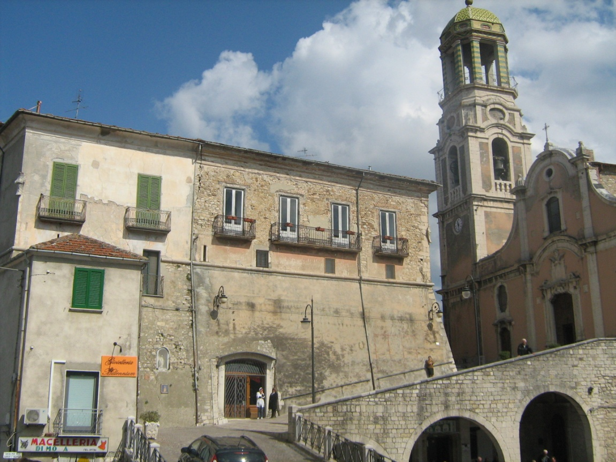
Our treasure: the Palace of Marquis
In our village there is a beautiful palace built around 1000. Its structure has changed over the centuries.

Slide 7
The doorway is adorned by a frame and it was protected by a drawbridge. Before going up to the noble floors, there is a large courtyard.

Slide 8
Theatre room, the dining room and the chapel are very beautiful

Slide 9
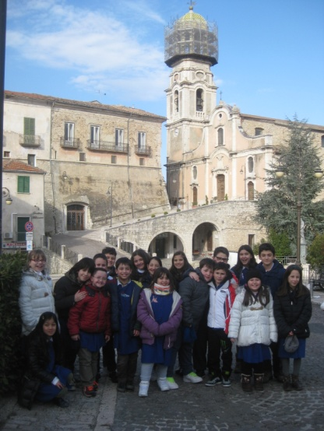
In Ripalimosani there are 7 churches.
The most popular and important is the Saint Maria Assunta church with interesting bell tower.

Slide 10
In San Michele Square there are Irma Fountain and the Croce Viaria. Irma Fountain was forged in Paris in 1900. The Croce Viaria was built in 1562.

Slide 11
St Micheal, the patron of Ripalimosani.

Slide 12
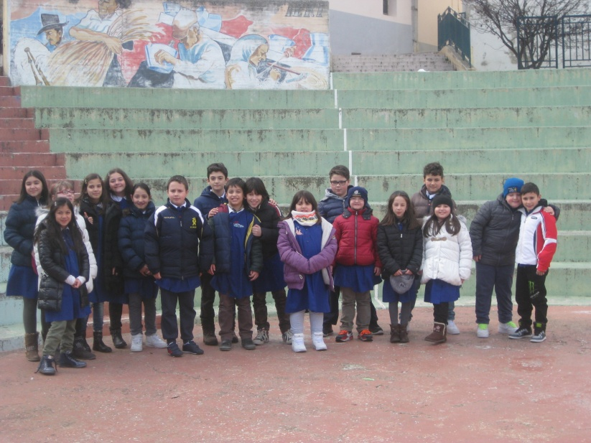
THE amphitheater In Summer you can dance, sing and act. We love playing here.

Slide 13
Historical centre of Ripalimosani

Slide 14
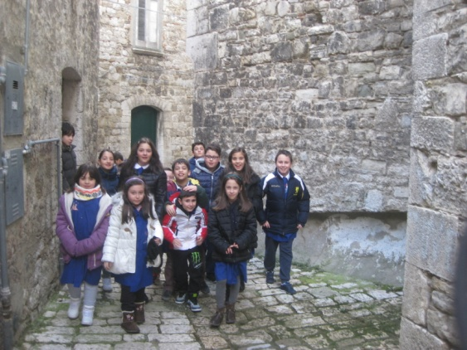
A walk through the historical centre

Slide 15
The staircase that goes to the square

Slide 16
THE HOUSES
There are old and new buildings, palaces, villas…

Slide 17
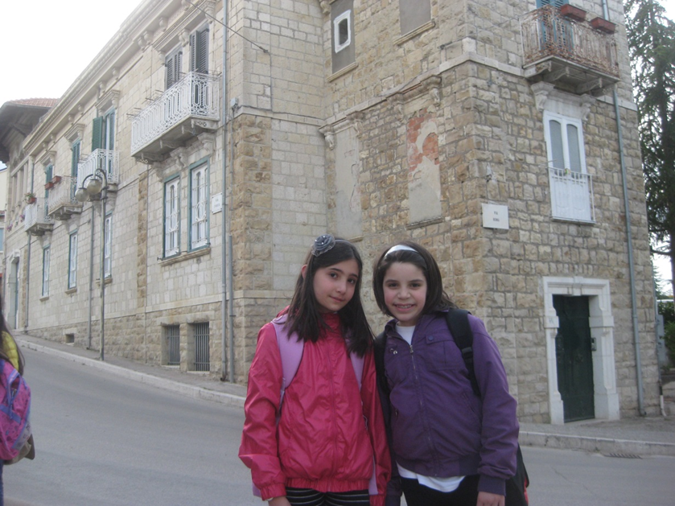

Slide 18
We greet you with this job and wish you
HAPPY HOLIDAYS

